Slide 1


EVENTEASE
Event Management Mobile App for Attendee Self Service
2520090212- J Rakshitha
2520090214- N Charishma
2520090067- Sahasra
Events Made Simple and Smart

Slide 2


ABSTRACT
Traditional event management often requires attendees to depend on organizers or volunteers for registration, schedules, venue information, and announcements.
This dependency can result in long queues, repeated queries,
communication gaps, and difficulty in managing attendee information. EventEase is a mobile self-service platform designed to give attendees independent and convenient access to event services.
Attendees can create accounts, browse and register for events, view
schedules, select or track sessions, and access venue and speaker details.
The system centrally manages attendee, event, session, registration,
venue, speaker, and notification data.
The main goal is to reduce manual workload for organizers and provide attendees with faster, organized, and independent event services.

Slide 3
PROBLEM STATEMENT
Attendees often depend on organizers for basic event services. Manual registration and information sharing can cause delays and long queues.
Repeated queries about schedules, venues, and speakers
increase organizer workload.
Communication gaps may occur when organizers are unavailable.
Seat allocation and registration status can be difficult to
manage manually.
A centralized self-service system is needed for faster and organized event management.

Slide 4
MOTIVATION
Reduce dependency on organizers and volunteers. Provide attendees with information anytime.
Make registration faster and more convenient. Provide automatic seat allocation after confirmation. Handle payments and transactions consistently.
Allow attendees to raise complaints when organizers are unavailable. Improve the overall event experience.

Slide 5
OBJECTIVES
Develop a centralized event management database. Allow attendees to browse and register for events.
Provide schedules, session, venue, and speaker information.
Process registrations and payments using transactions.
Automatically allocate seats after successful confirmation.
Provide notifications and attendee support. Reduce manual workload for organizers.

Slide 6
LITERATURE SURVEY
Existing event management systems mainly focus on event registration and attendee management.
Many systems provide event schedules, venue details, and session information.
Online platforms reduce manual work by providing digital registration and event information.
Database-based systems help manage attendees, events, sessions, and registrations efficiently.
Some systems support notifications and attendee communication.
However, attendee services such as transactions, seat allocation, and complaint handling are often handled separately.
These observations helped us design EventEase as an integrated attendee self-service system.

Slide 7
RESEARCH GAP
Existing systems mainly focus on event registration and information management.
Attendees may still depend on organizers for support and event-related queries.
Transaction processing and seat allocation are not always integrated into the attendee workflow.
Complaint handling and escalation may be managed separately.
There is a need for a centralized self-service platform combining these functions.
EventEase addresses this gap by integrating registration, transactions, seat allocation, notifications, and complaint management.

Slide 8
PROPOSED METHODOLOGY
Requirement Analysis – Identify attendee and organizer requirements.
Database Design – Define entities, relationships, keys, and constraints.
Normalization – Reduce data redundancy and maintain consistency.
Backend Development – Develop REST APIs for application and database operations.
Frontend Development – Build the EventEase web interface for attendee self-service.
Testing & Integration – Test queries, APIs, registration, transactions, and seat allocation.
Final Integration – Connect Frontend → REST API → MySQL Database.

Slide 9
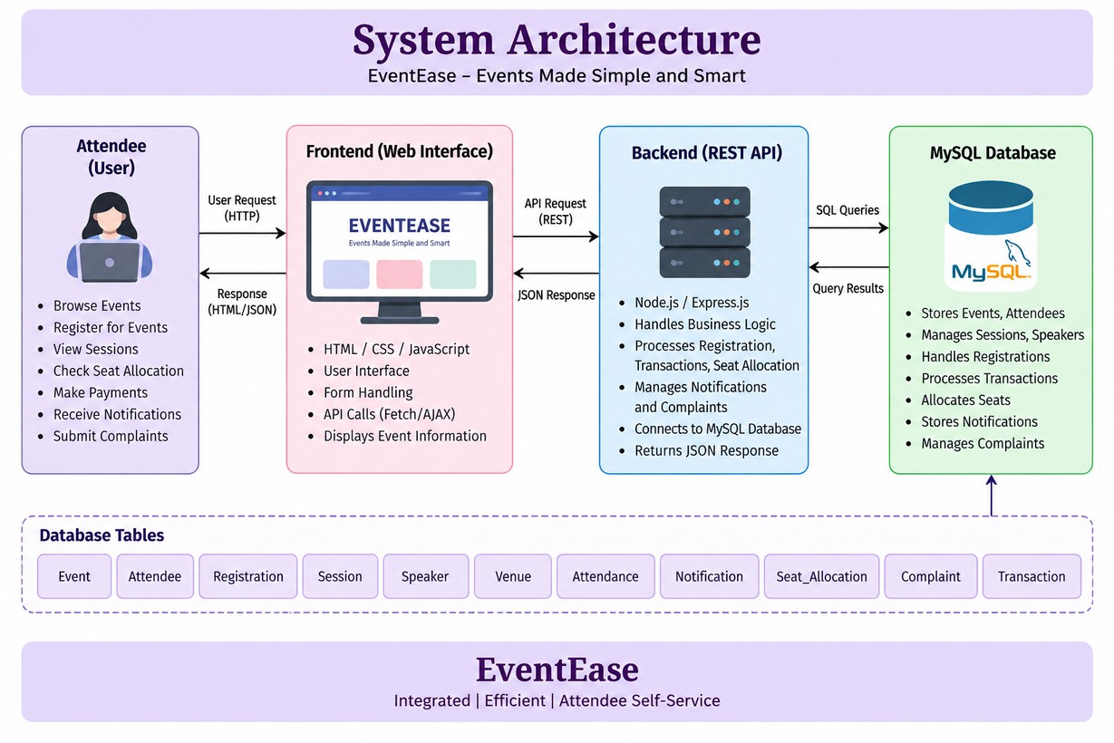
SYSTEM ARCHITECTURE

Slide 10

TECHNOLOGIES USED
Frontend: HTML, CSS, JavaScript Backend: Node.js, Express.js API: REST API
Database: MySQL
Development Tool: Visual Studio Code Database Concepts: SQL, Joins, Normalization, Transactions
Data Format: JSON for frontend–backend communication

Slide 11
DATASET
The dataset is designed for an event management and attendee self-service system.
It contains information related to attendees, events, registrations, sessions, speakers, and venues.
It also includes seat allocation and transaction details for managing event participation.
Attendance, notifications, and complaints are included to support attendee services.
The dataset contains 2,500 attendees and 200 events with multiple registrations and sessions.
Registration and transaction data are used to demonstrate database transactions and seat allocation.
The dataset is used as the input for database design, SQL operations, API development, and system testing.

Slide 12


IMPLEMENTATION – MODULE 1
EVENT & VENUE MANAGEMENT
Add and manage event details Assign a unique Event ID
Assign a separate venue for each event Store venue name, location and capacity Maintain event category and schedule Display available events to attendees

Slide 13



IMPLEMENTATION – MODULE 2
REGISTRATION & SEAT MANAGEMENT
Attendee enters personal details to register Generate unique Registration ID
Maintain attendee and event relationship
Process seat allocation for confirmed registrations Assign unique Seat ID and Seat Number
Track registration and seat status

Slide 14
IMPLEMENTATION – MODULE 3
TRANSACTION & SUPPORT MANAGEMENT
Record payment/transaction details Maintain transaction status Connect registration with payment
Allow attendees to submit complaints
Provide support contact numbers
Store complaint details for organizer response

Slide 15
EXPERIMENTAL SETUP
Frontend: HTML, CSS, JavaScript
Backend: Backend API for application processing Database: EventEase relational dataset/database Development Tool: VS Code
Input: Event, attendee, registration, venue, session and transaction data
Testing: Event search, registration, support and seat-related workflows

Slide 16


RESULTS
Events can be displayed and searched easily Attendees can view complete event information Registration form collects attendee details Unique Registration ID is generated
Event and venue information is displayed
Support and complaint functionality is provided Registration, transaction and seat allocation can be integrated through the backend

Slide 17



PERFORMANCE EVALUATION
Event Search: Quickly filters available events Registration: Collects required attendee information Data Management: Maintains related event and attendee records
Seat Management: Supports unique seat allocation Transaction Management: Tracks payment information
Support: Allows complaints to be submitted when organizers are unavailable

Slide 18

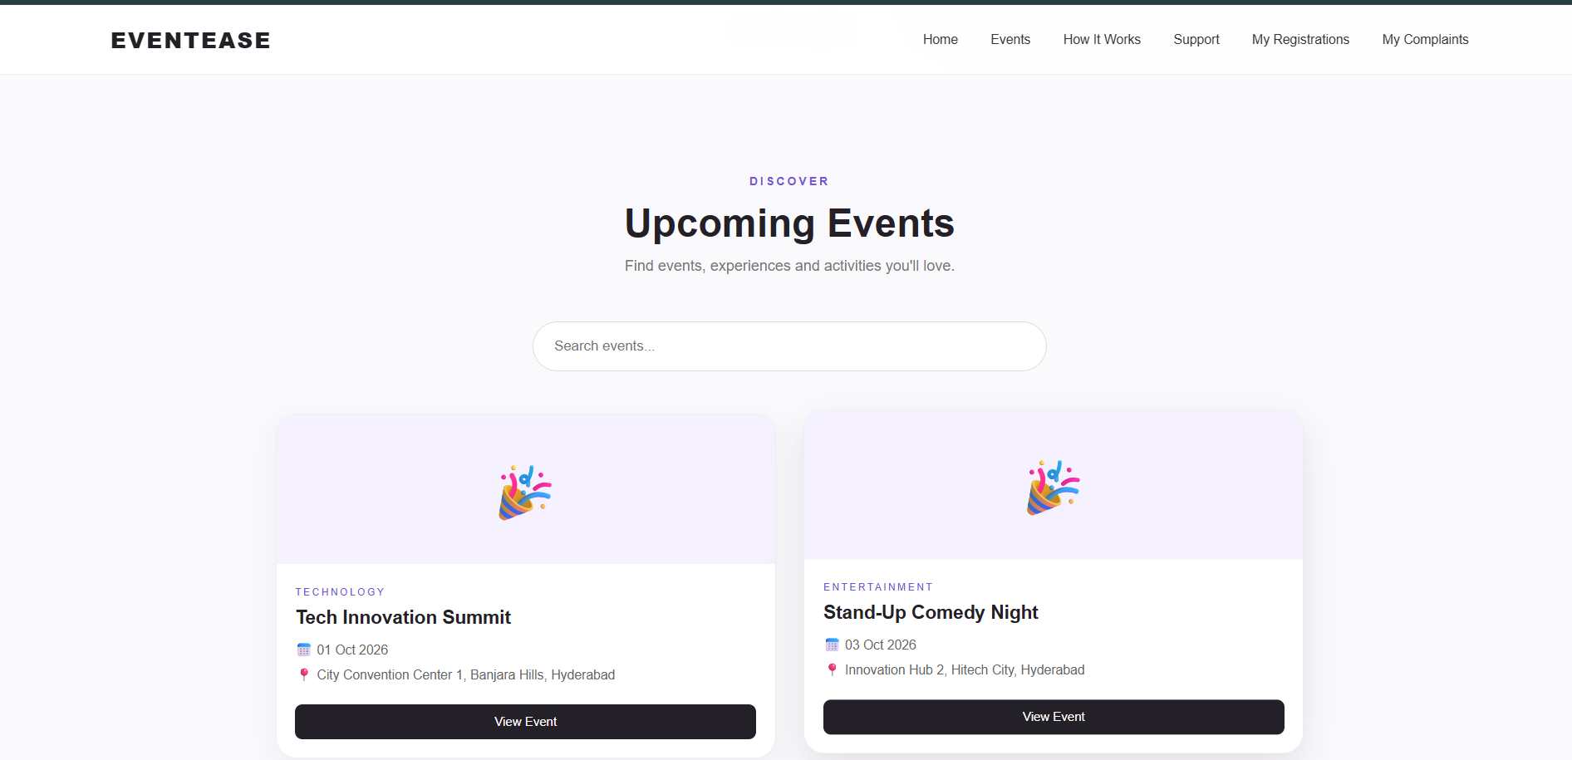
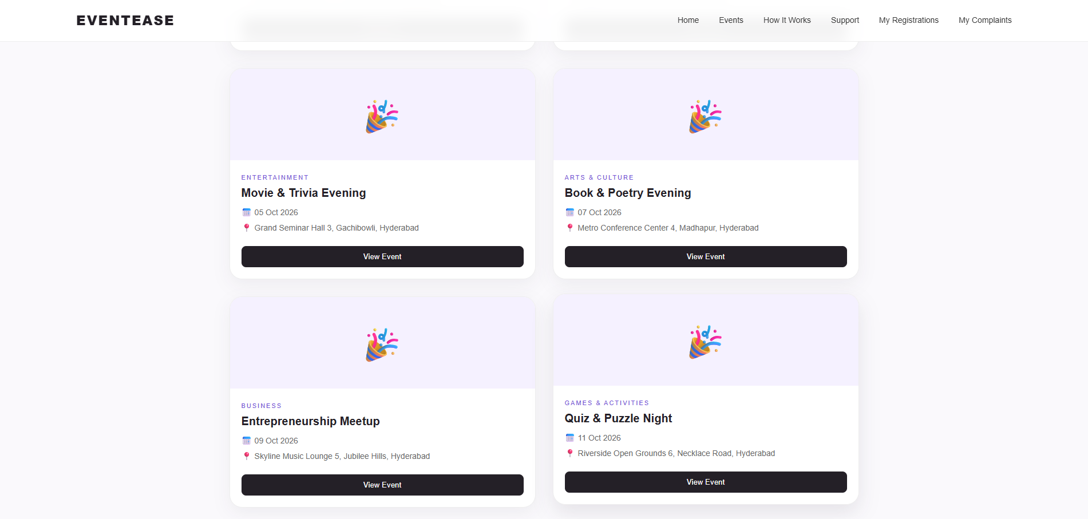
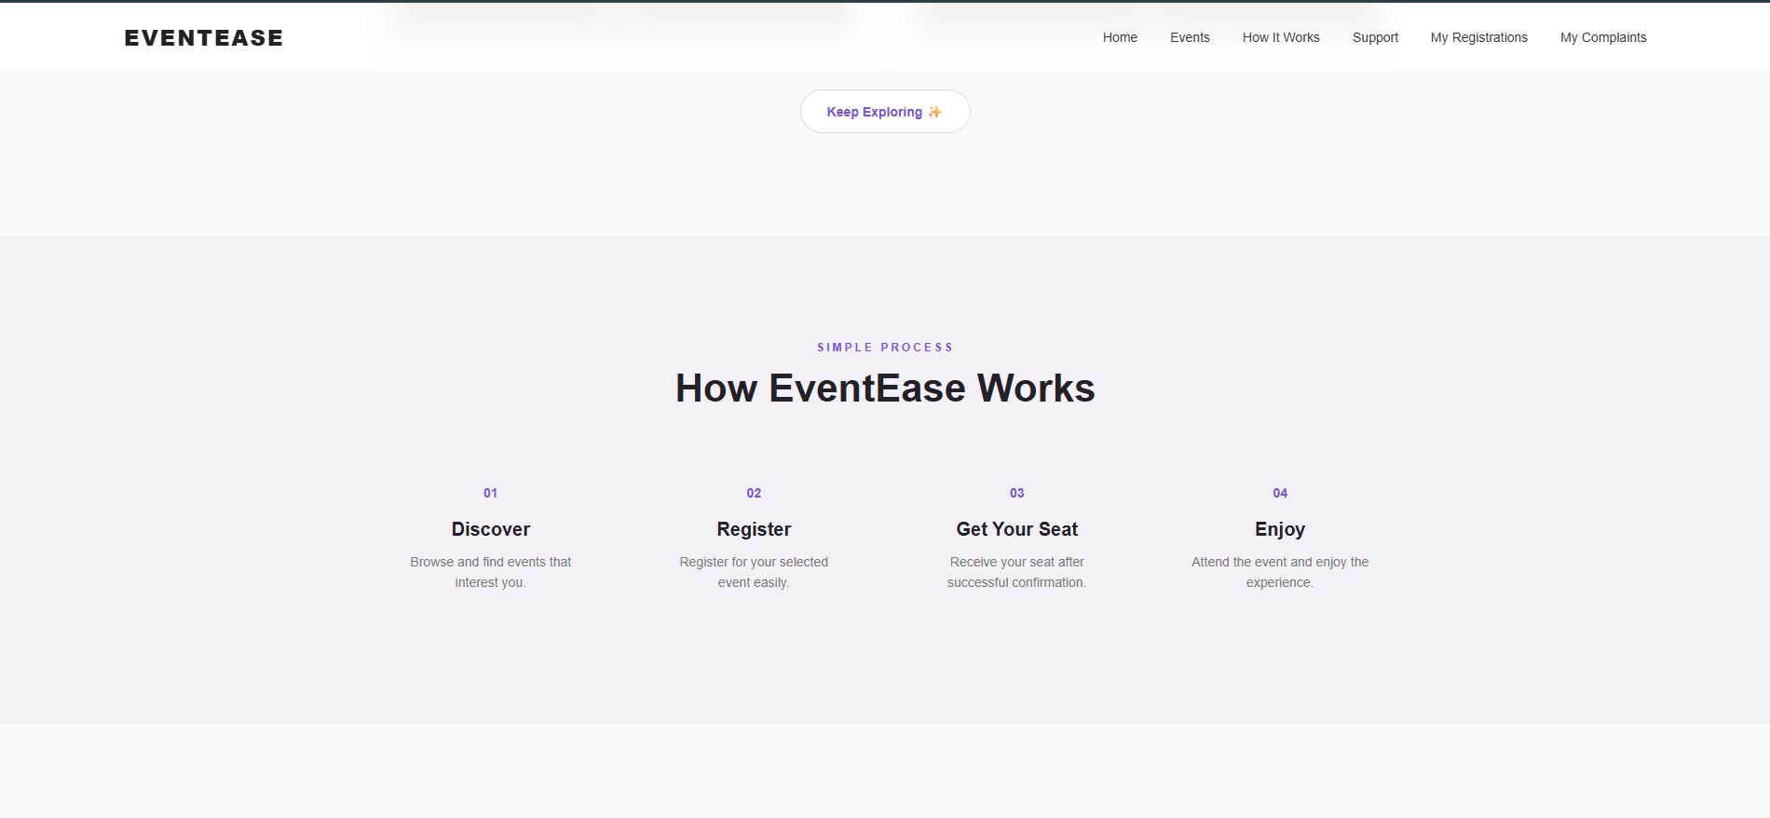
WORKING DEMO

Slide 19
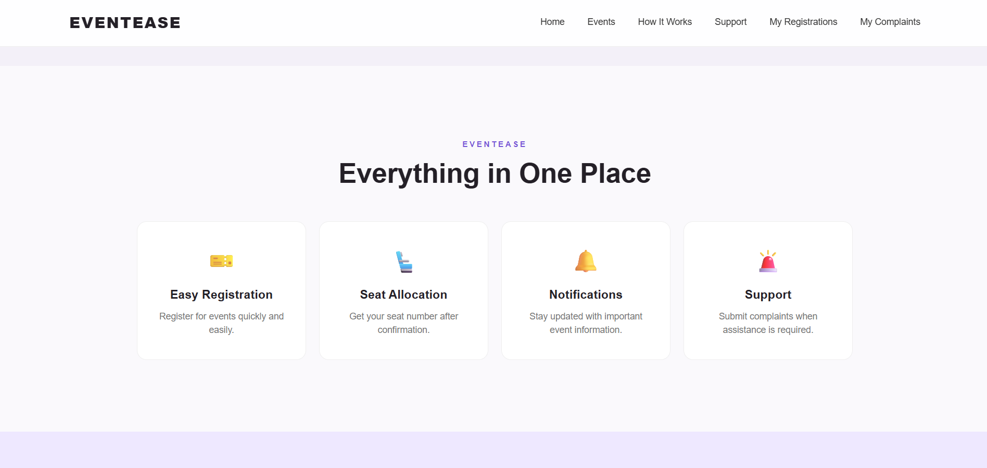
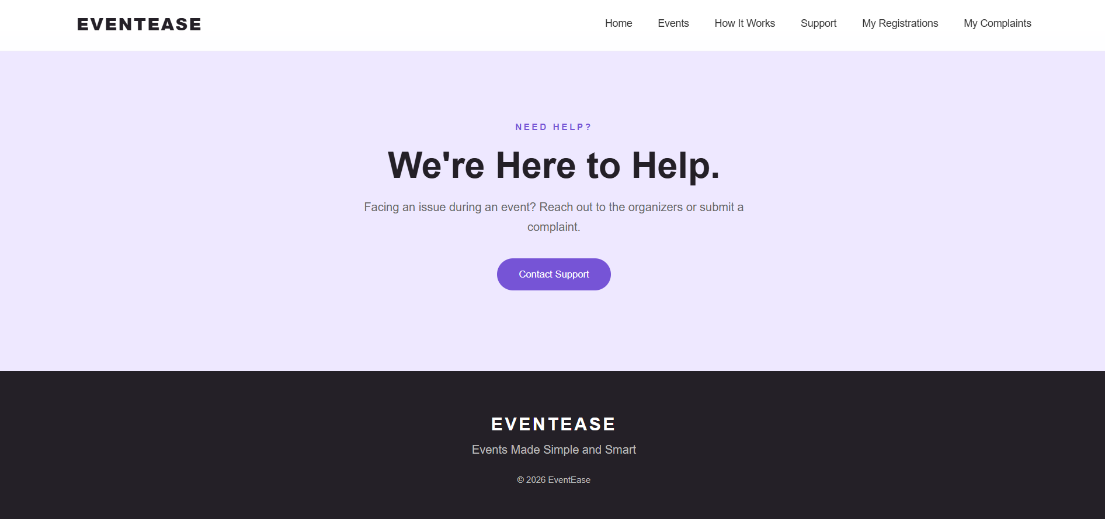
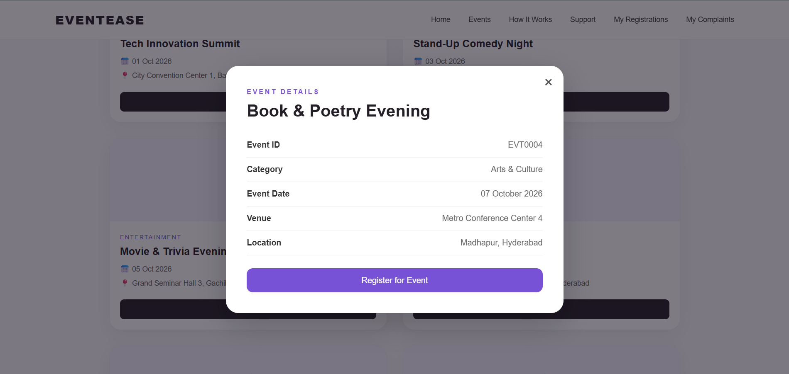
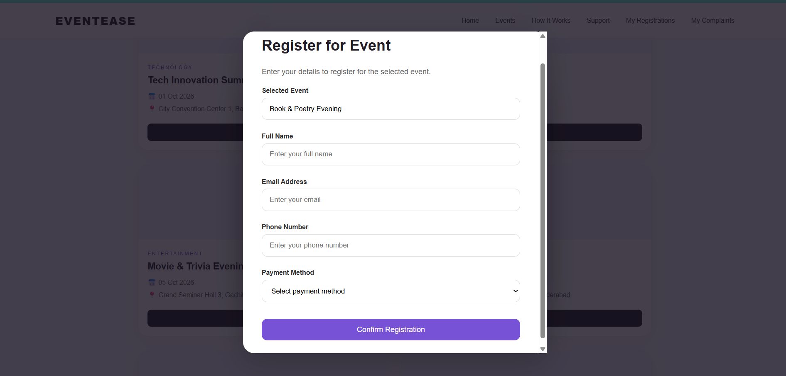
WORKING DEMO

Slide 20
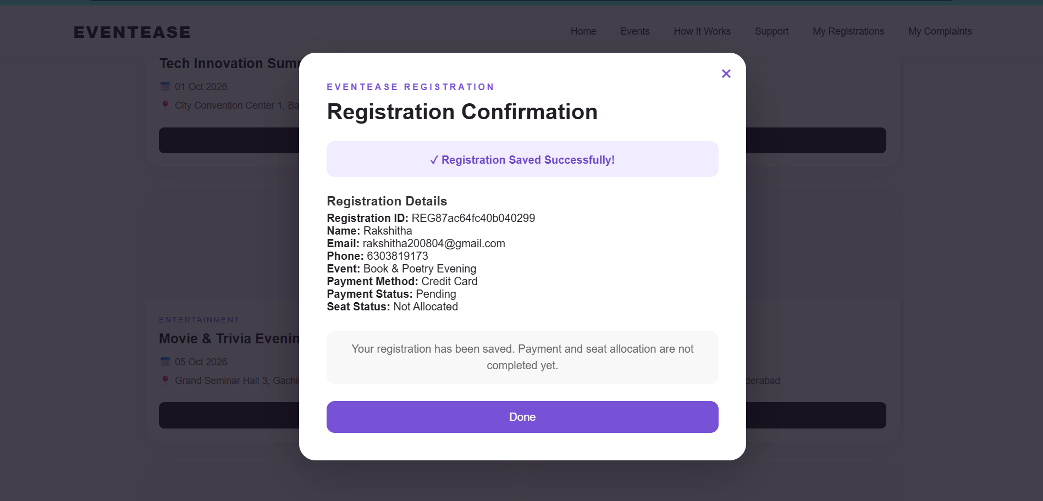
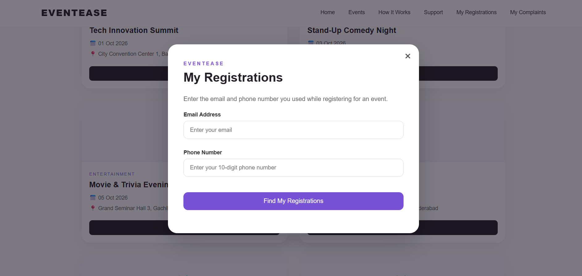
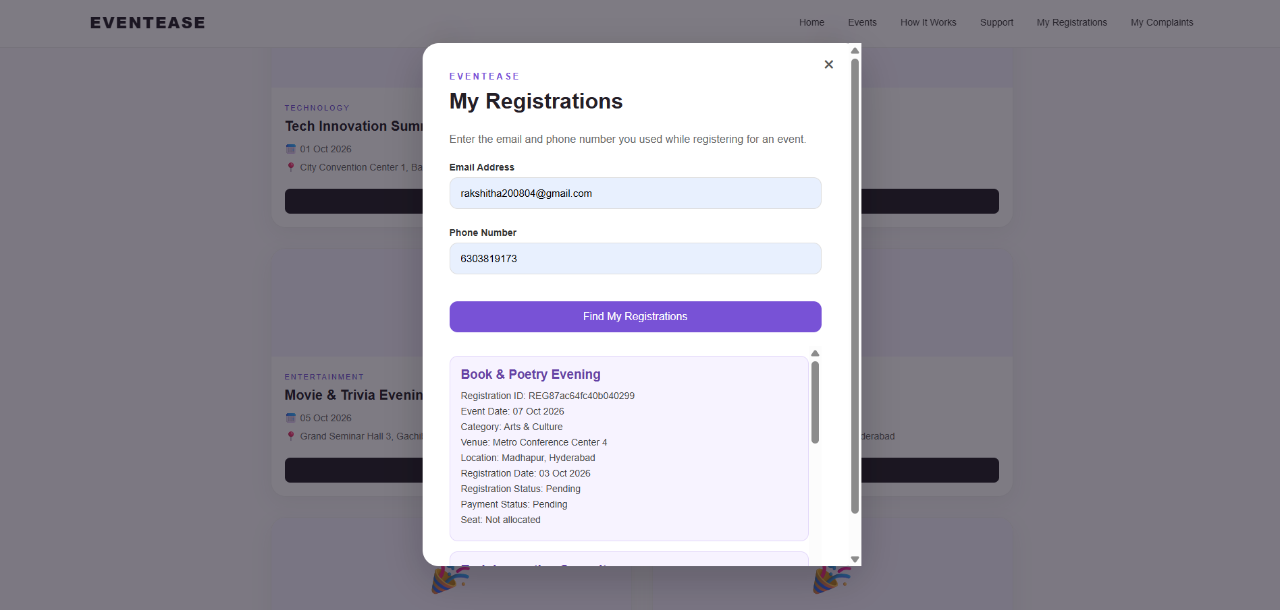
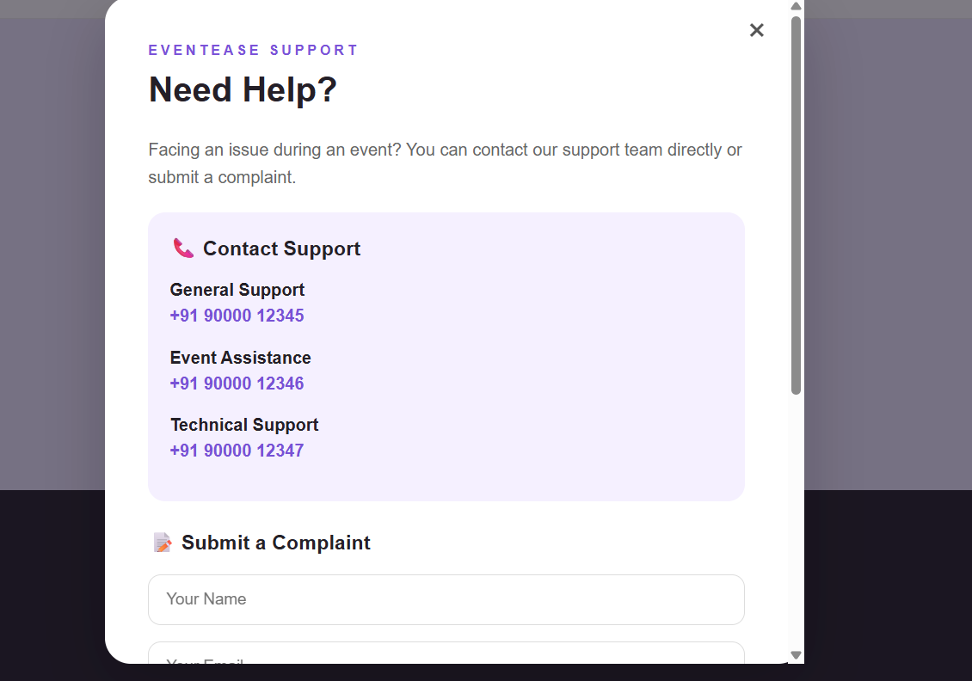
WORKING DEMO

Slide 21
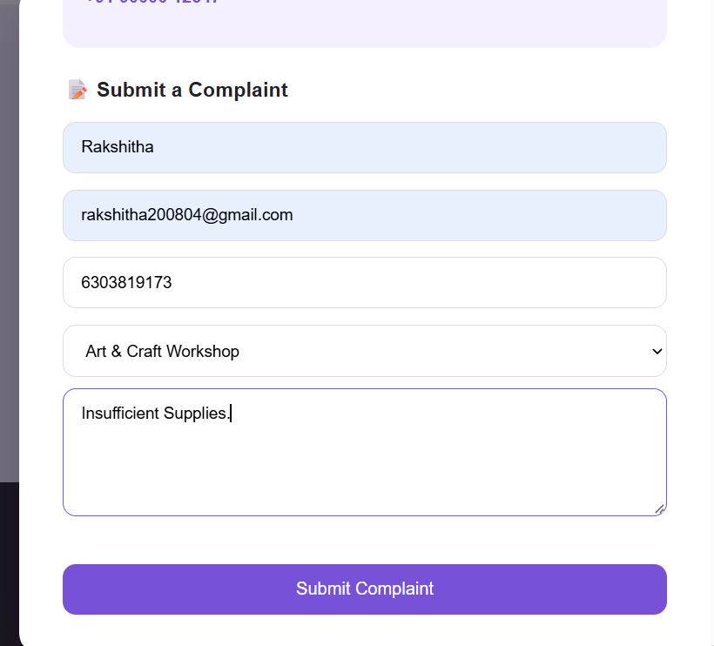
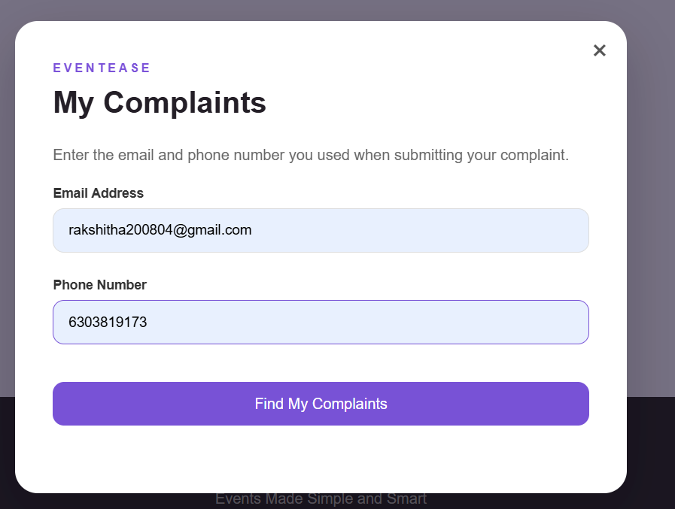
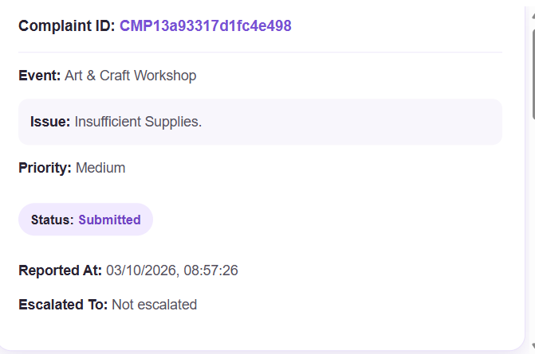
WORKING DEMO

Slide 22
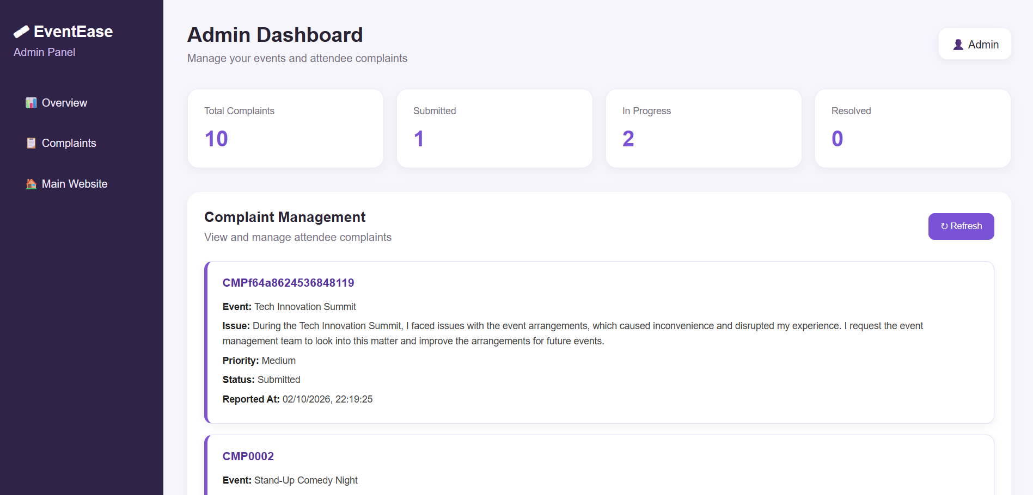
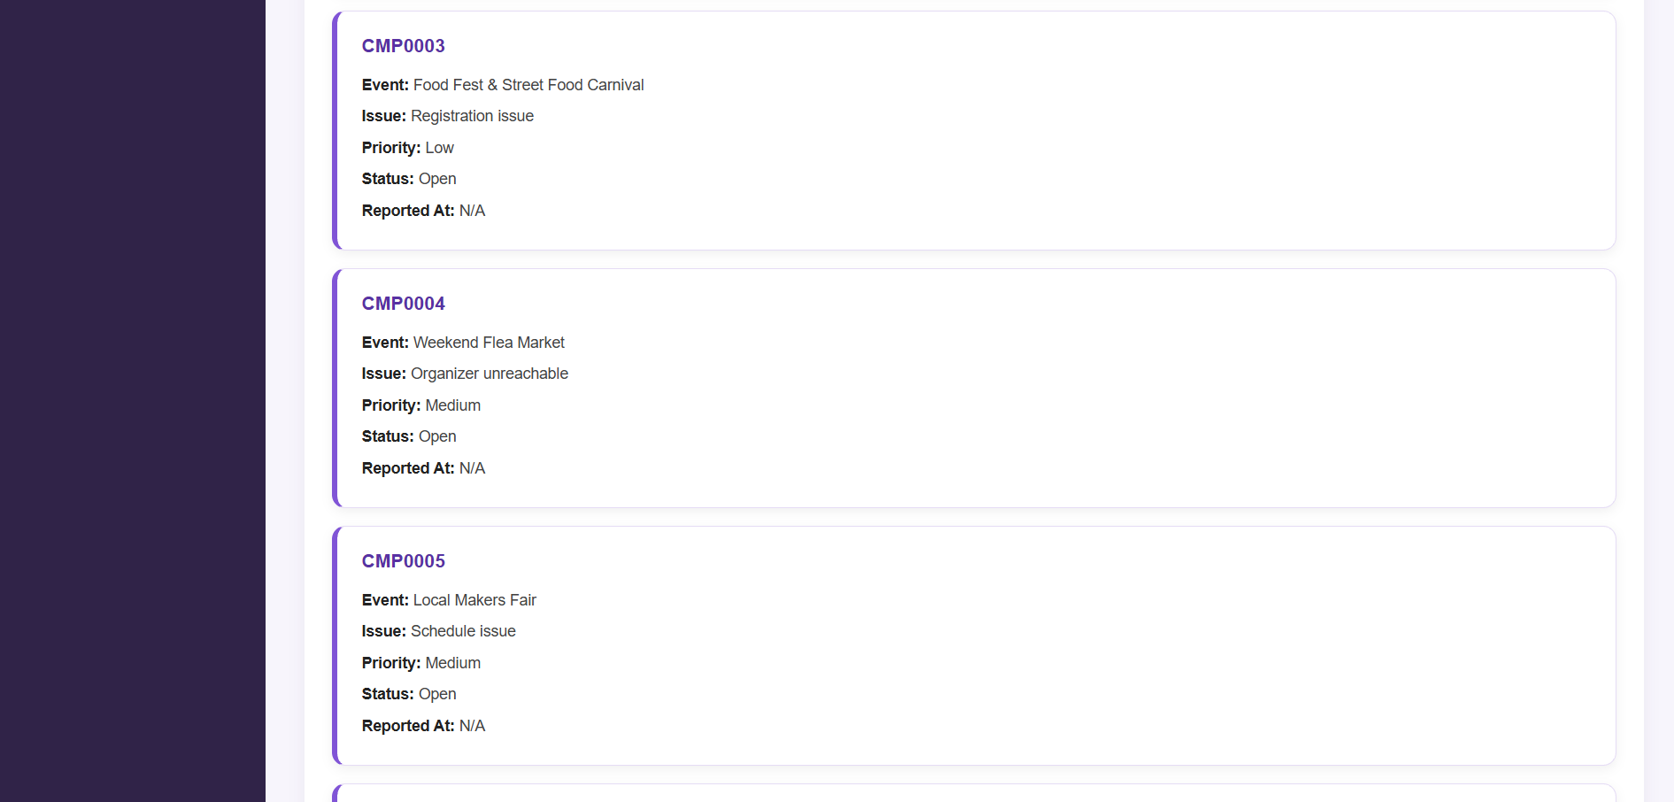
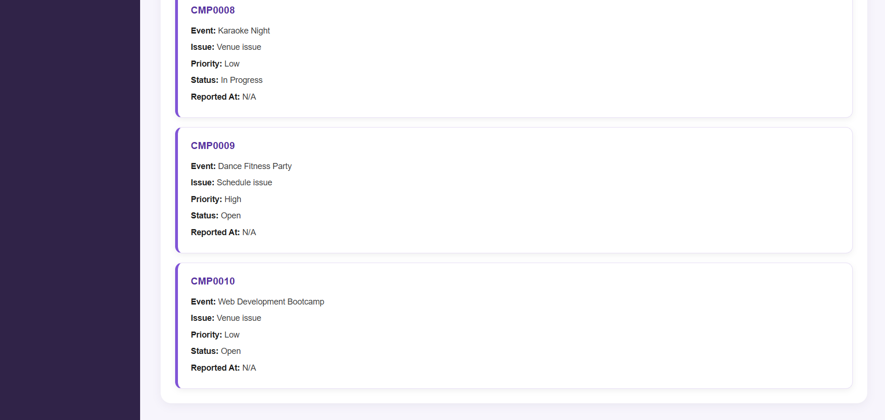
WORKING DEMO

Slide 23
COMPARISON WITH EXISTING SYSTEM
Existing Event Systems | EventEase
Mainly focused on event discovery | Event discovery + management
Registration handled separately in some cases | Integrated registration
Seat management may be separate | Seat allocation integrated
Limited attendee support | Complaint + support functionality
Payment information may be handled separately | Transaction management
Less focus on relational data management | Database-oriented design

Slide 24
CHALLENGES & SOLUTIONS
Challenges | Solutions
Managing multiple related entities | Relational database design
Maintaining attendee and registration relationships | Unique IDs for entities
Avoiding duplicate seat allocation | Seat allocation tracking
Managing different event venues | Event–venue relationship
Handling transaction information | Transaction records
Providing support when organizers are unavailable | Complaint and support module

Slide 25
FUTURE WORK
Integrate the frontend with a live backend database Implement real-time seat availability
Integrate secure online payment Add email/SMS notifications Provide attendee dashboards Add organizer/admin dashboard
Generate event and transaction reports
Improve mobile responsiveness

Slide 26



CONCLUSION
EventEase provides an integrated event management system.
It manages events, attendees, registrations, venues, sessions, speakers and seats.
Registration details can be connected with transactions and seat allocation.
Attendees can access event information and support services.
The system provides a structured approach to managing event-related data.

Slide 27
REFERENCES
Database Management System textbooks and course materials
HTML, CSS and JavaScript documentation MySQL documentation
Research papers related to Event Management Systems
References used for literature survey

Slide 28
THANK YOU

